Slide 1
SEP New Feedback Testing
Oct 28th 2019
Anubhav Mittal

Slide 2
Who we tested with
15 Online un-moderated test sessions, with Userzoom panel, for usability testing
Screener used to find Business Owners or decision makers

Slide 3
Summary
The feedback made sense to people as it followed a well known design pattern
They suggested that some options could be added but did not state what they should be
The form’s brevity was welcomed
Many expected it to be a one stage process and populate a ratings scale
Expected to leave contact details and get some kind of response and a copy of what they submitted.

Slide 4
What we were trying to find out
We were interested in:
How would users provide feedback when on the website
Test different feedback options and provide their thoughts
If there was anything missing
Starting URL: https://i3950z.axshare.com

Slide 5
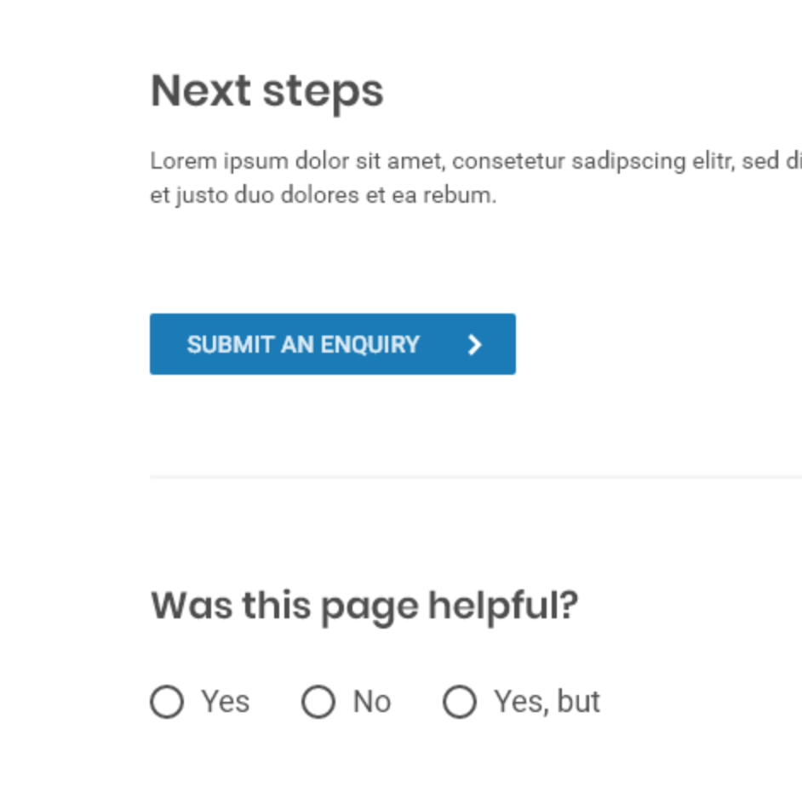
On page feedback
People liked the feedback options as they were easy to notice and were at the bottom of the content where they expected them.

Slide 6
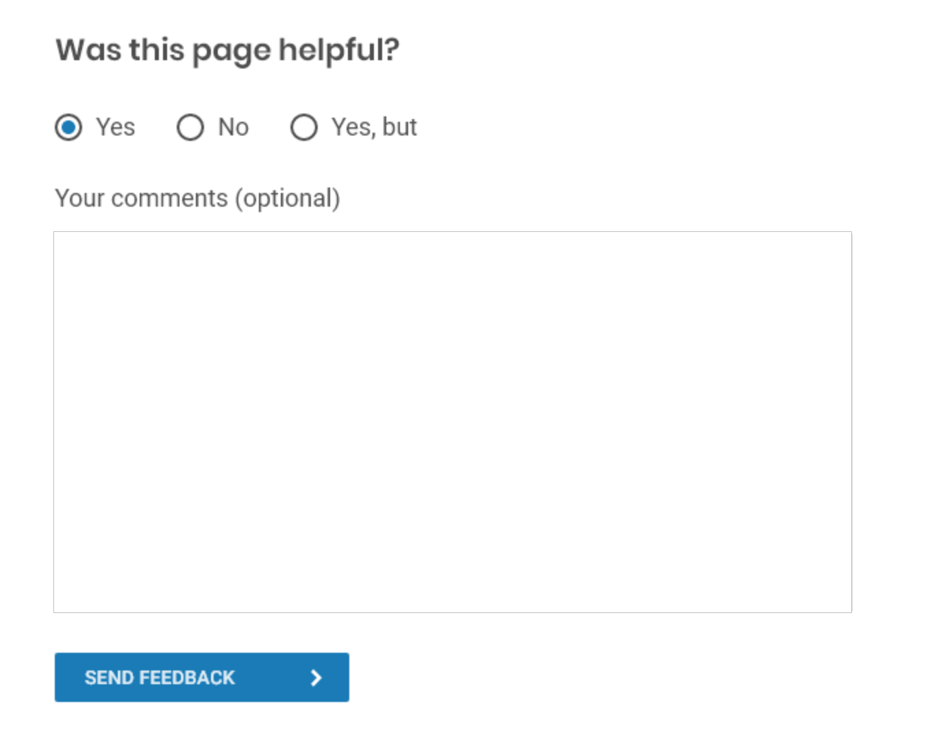
On page feedback YES
People were 50/50 between wanting to leave a comment as opposed to expecting it to be a single stage process
The single stage people expected it to create a rating or star scale
People suggested that having a feedback acknowledgement, would be beneficial
People also suggested having inputs copied to their own email

Slide 7
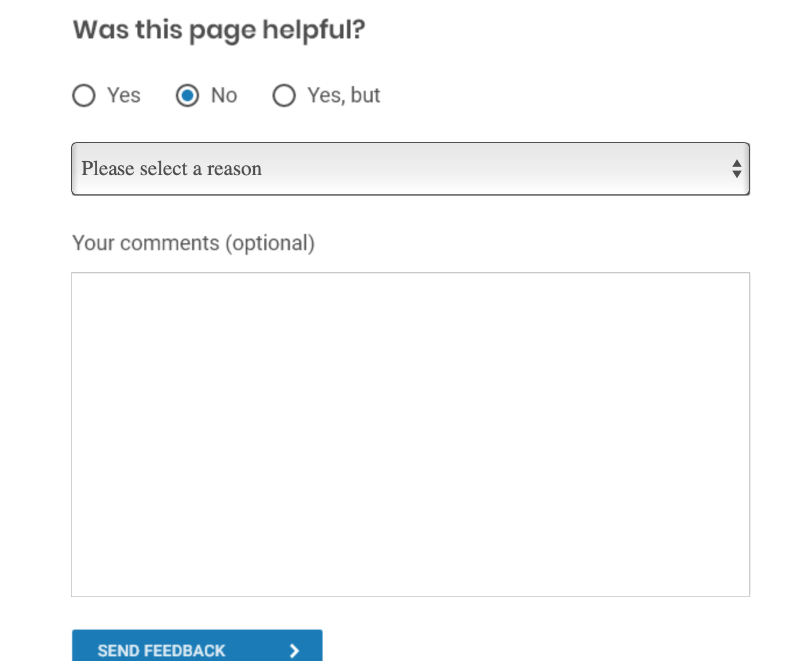
On page feedback NO
70% were in favour of leaving a comment after selecting NO
Dropdown menu was welcome and made sense
Expected to leave contact details and get a response
AND
A copy of their submission

Slide 8
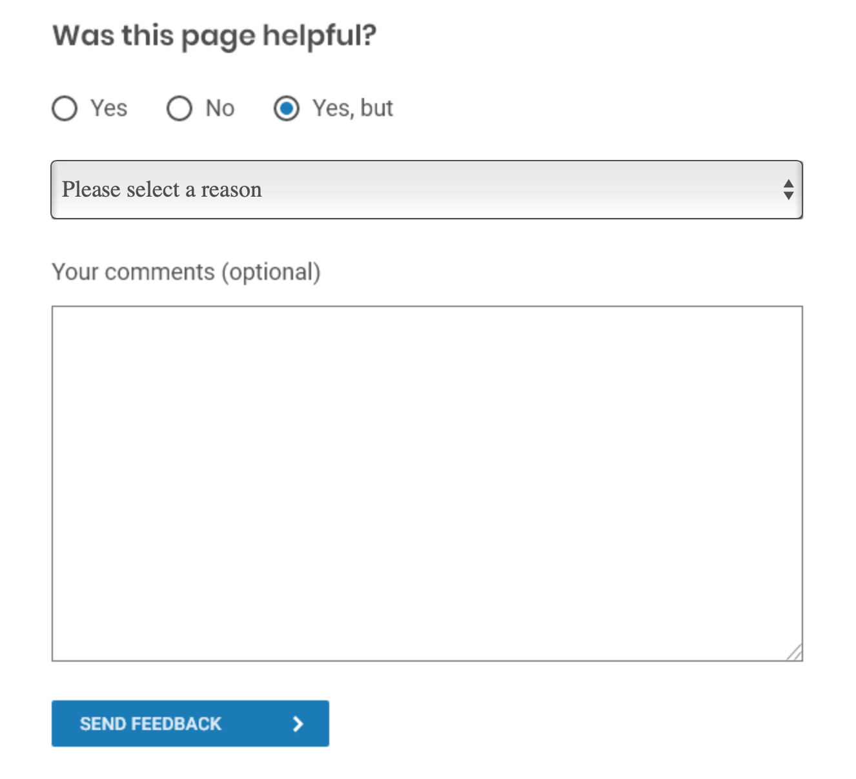
On page feedback YES, BUT
60% were in favour of leaving a comment after selecting YES, BUT
Dropdown menu was welcome and made sense
Expected to leave contact details and get a response
AND
A copy of their submission

Slide 9
SEP Feedback Quotes
Feedback option was easy to find and straightforward
Easy form, helpful dropdown
The categories titles are clear and easy to understand
Would have liked to see a question as to whether I wanted to be contacted with respect to my specific problem and if yes then to be prompted for contact information.
When using the word ’but’, it is expected that I need to be precise in my feedback to help improve the page
Just the option to add an email for a response is missing
Maybe a star rating option would be a great little addition into overall feedback in general.
Nothing, sometimes it is good to be let known that you will receive a confirmation that it has been received and that you will get a response via email.
A title above where you enter your feedback eg Please provide your Feedback.
There could have been a star rating/symbols above the comments box to give a general score/overall rating.
What is positive is that you are helping the customers to voice their concerns when they choose no or yes but thanks to the drop-down menu, since it give them suggestions about what they can think of

